Slide 1
Javascript Basics

Slide 2
JavaScript Operators
JavaScript operators are symbols that are used to perform operations on operands.
There are following types of operators in JavaScript.
Arithmetic Operators
Comparison (Relational) Operators
Bitwise Operators
Logical Operators
Assignment Operators

Slide 3
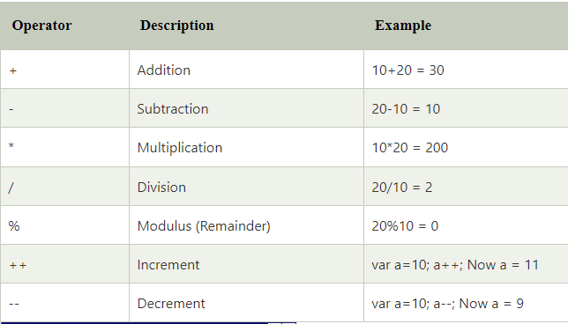
JavaScript Arithmetic Operators
Arithmetic operators are used to perform arithmetic operations on the operands. The following operators are known as JavaScript arithmetic operators.

Slide 4
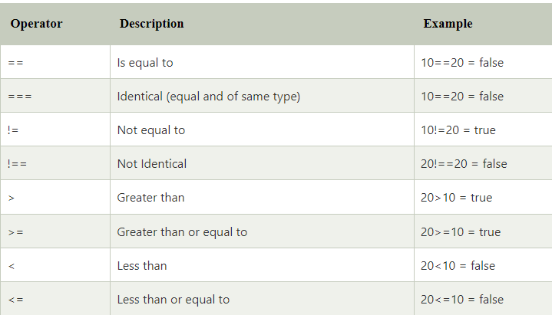
JavaScript Comparison Operators
The JavaScript comparison operator compares the two operands. The comparison operators are as follows:

Slide 5
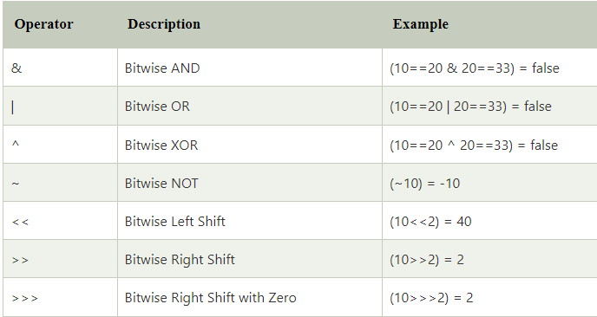
JavaScript Bitwise Operators
The bitwise operators perform bitwise operations on operands. The bitwise operators are as follows:

Slide 6
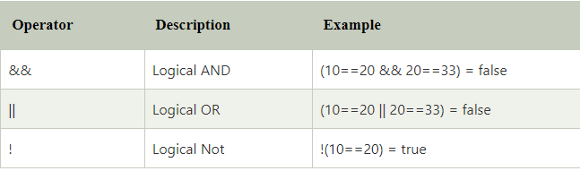
JavaScript Logical Operators
The following operators are known as JavaScript logical operators.

Slide 7
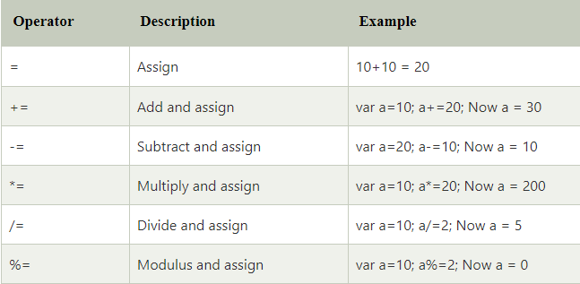
JavaScript Assignment Operators
The following operators are known as JavaScript assignment operators.

